Slide 1
Hotel Booking Cancellation Prediction
Data-Driven Insights
Presented by: Menna Khaled

Slide 2
About DataTalk & Our Goal
DataTalk is our initiative to transform raw data into actionable insights.
Our goal:
• Predict hotel booking cancellations.
• Understand customer behavior and booking patterns.
• Provide strategic recommendations to optimize pricing, marketing, and operations.

Slide 3
Data Overview & Preprocessing Summary
Dataset Size: 35337 records and 21 columns.
Columns: Booking_ID, number of adults, number of children, number of weekend nights, number of week nights, type of meal, car parking space, room type, lead time, market segment type, repeated, P-C, P-not-C, average price, special requests, date of reservation, booking status, reservation_year, reservation_month, total_nights, season
Brief Description:
This dataset contains hotel booking records with details on reservation dates, customer demographics, booking specifics (e.g., number of adults, room type, meal type), pricing, and cancellation information.
Preprocessing Steps:
• Cleaned column names and converted reservation dates to datetime.
• Engineered features such as total nights booked, reservation year/month, and season.
• Removed outliers in average price to focus on typical pricing patterns.

Slide 4
Agenda
1. Data Overview & Preprocessing
2. Exploratory Data Analysis (EDA)
3. Key Insights & Trends
4. Strategic Recommendations
5. Q&A

Slide 5
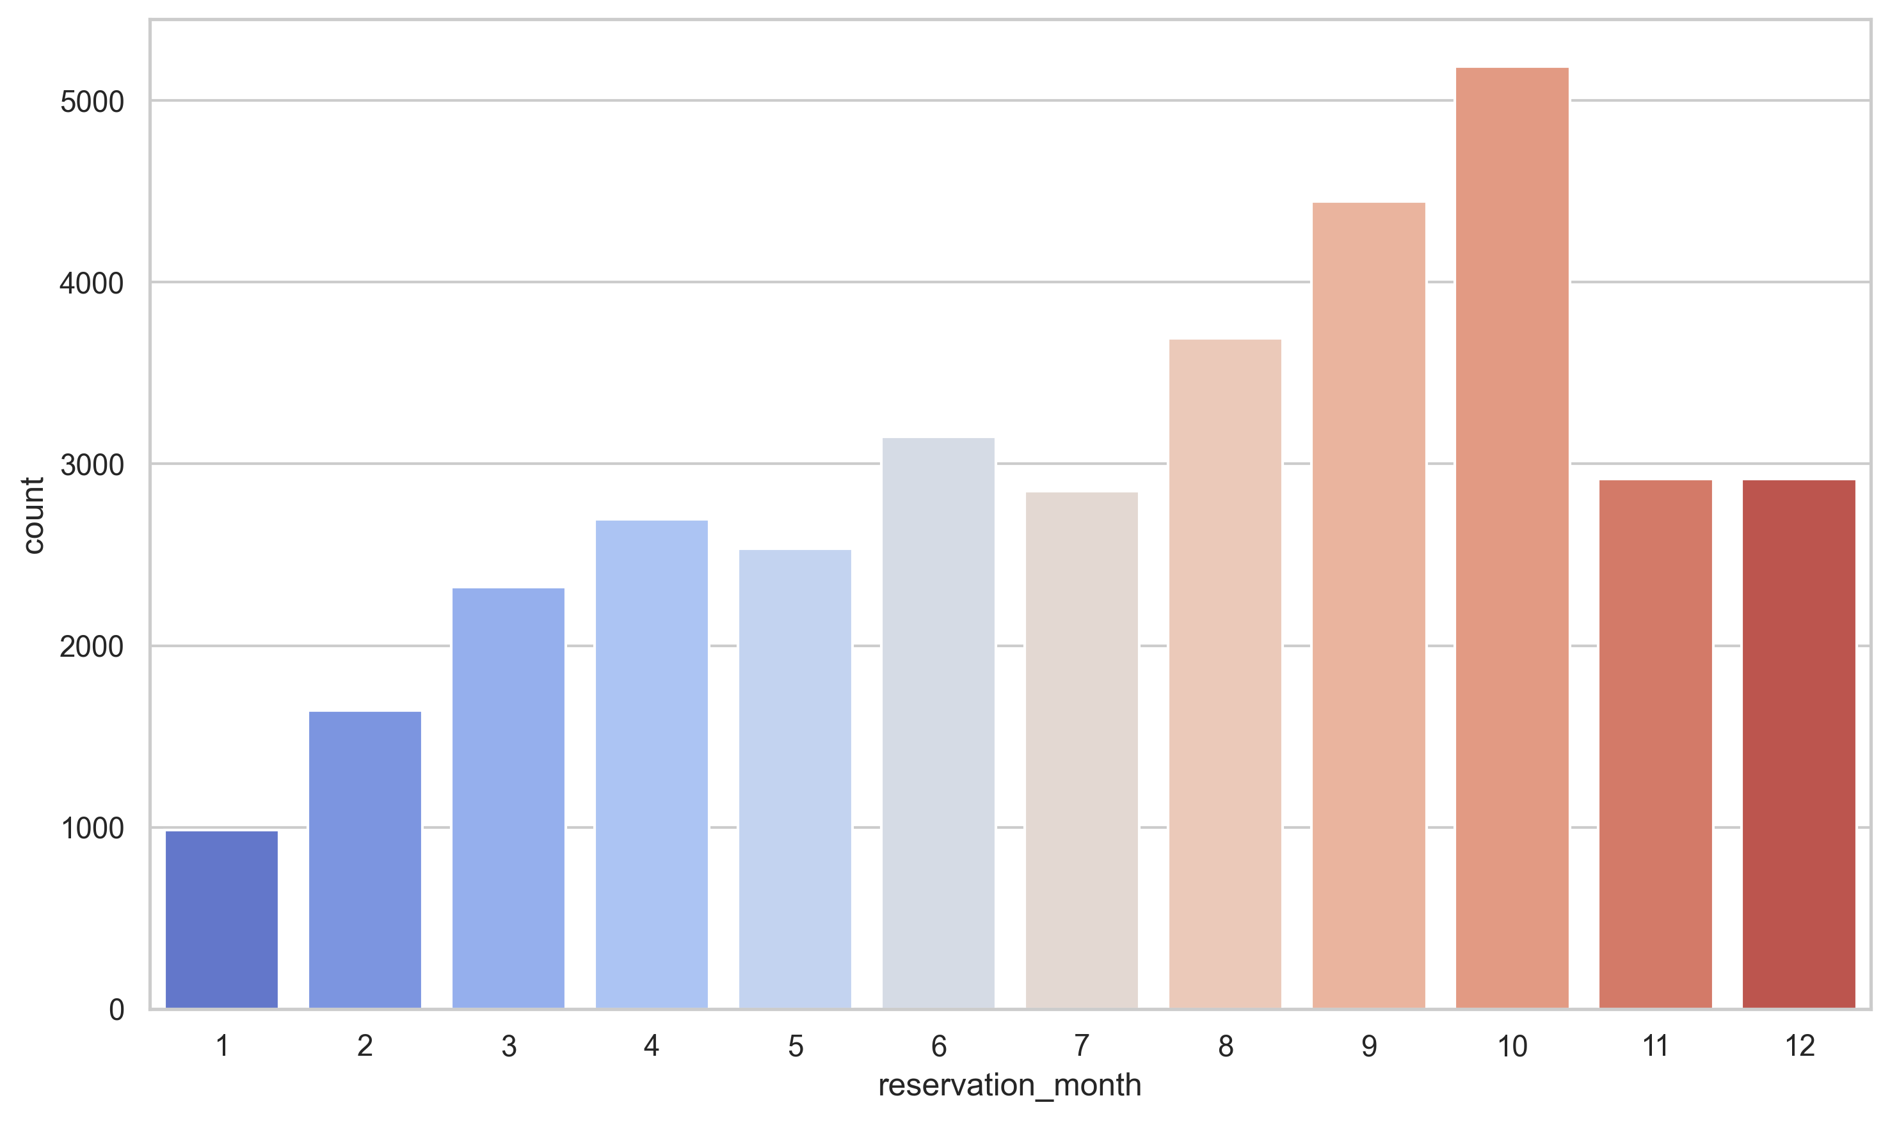
Seasonal Booking Patterns
Monthly reservation counts show clear seasonality.
High-demand months can drive targeted promotions.

Slide 6
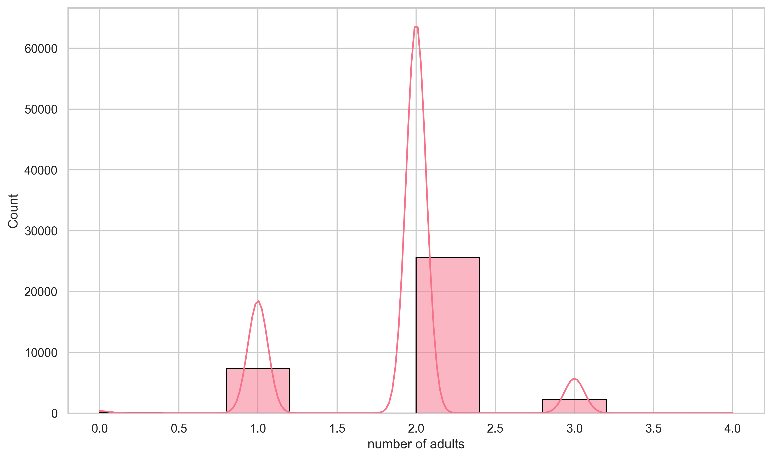
Distribution of Adults per Booking
Majority of bookings consist of 1-2 adults.
Provides insight into typical customer profiles.

Slide 7
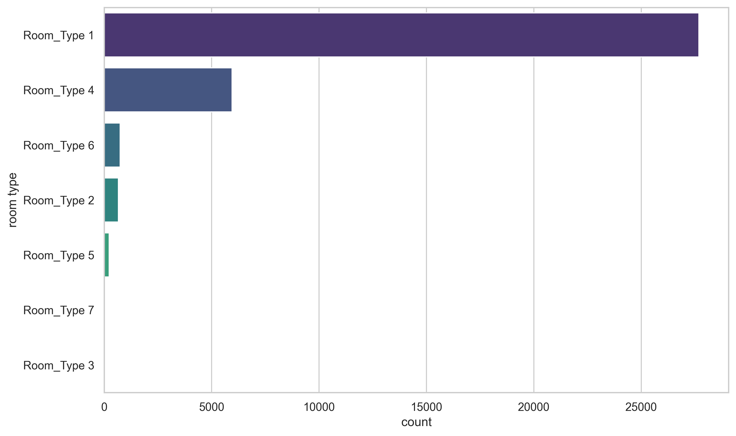
Room Type Preferences
Certain room types dominate the market.
Essential for inventory and pricing strategy.

Slide 8
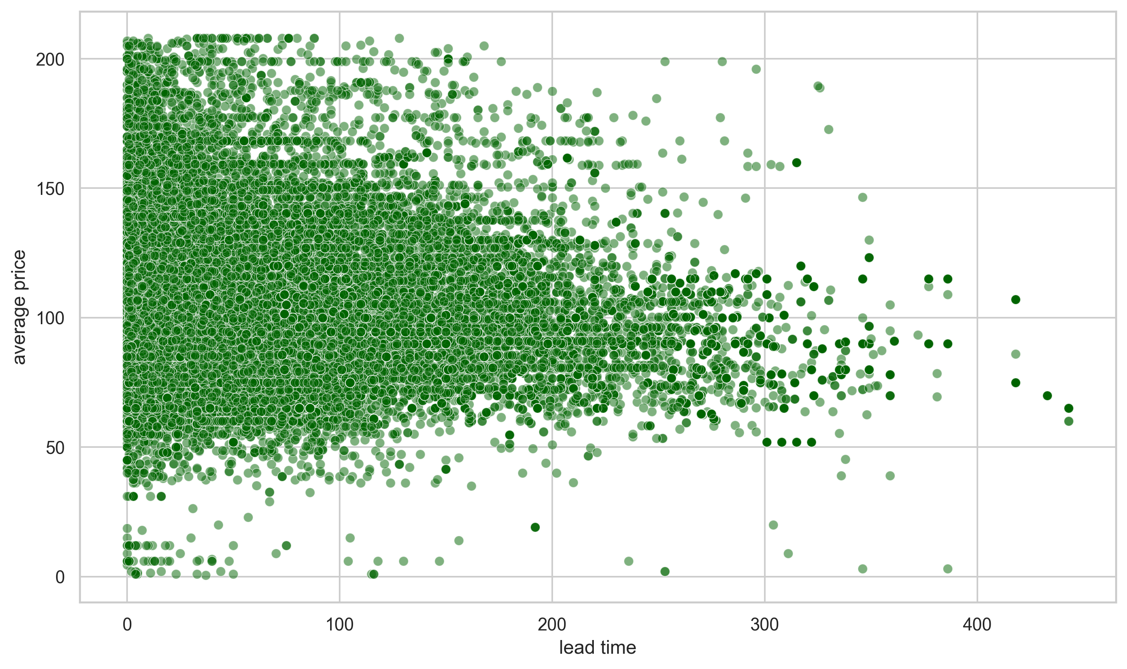
Pricing Strategy Insights
Longer lead times correlate with higher average prices.
Supports dynamic pricing models.

Slide 9
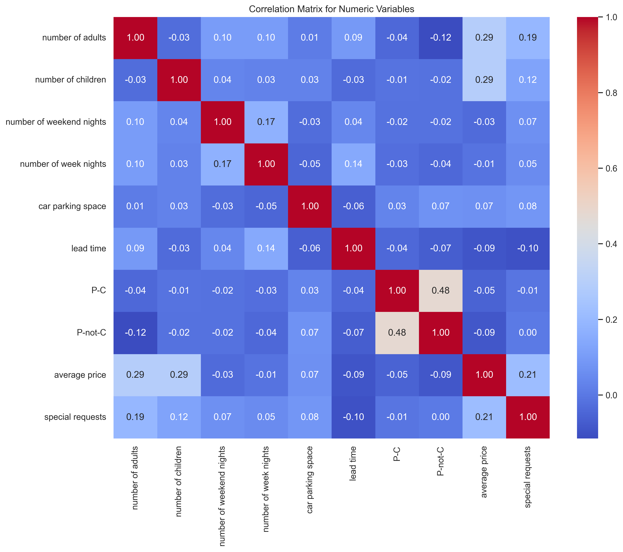
Correlation Among Key Variables
Heatmap reveals interdependencies among numeric features.
Highlights drivers of customer behavior.

Slide 10
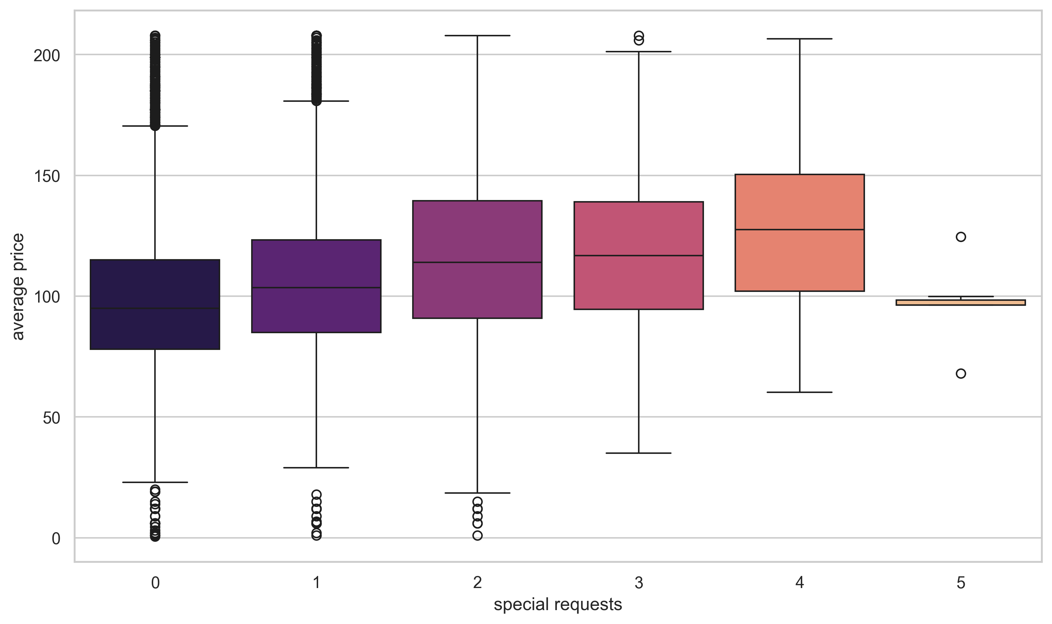
Special Requests & Price Impact
Customers with more special requests tend to pay higher prices.
Opportunity to customize services.

Slide 11
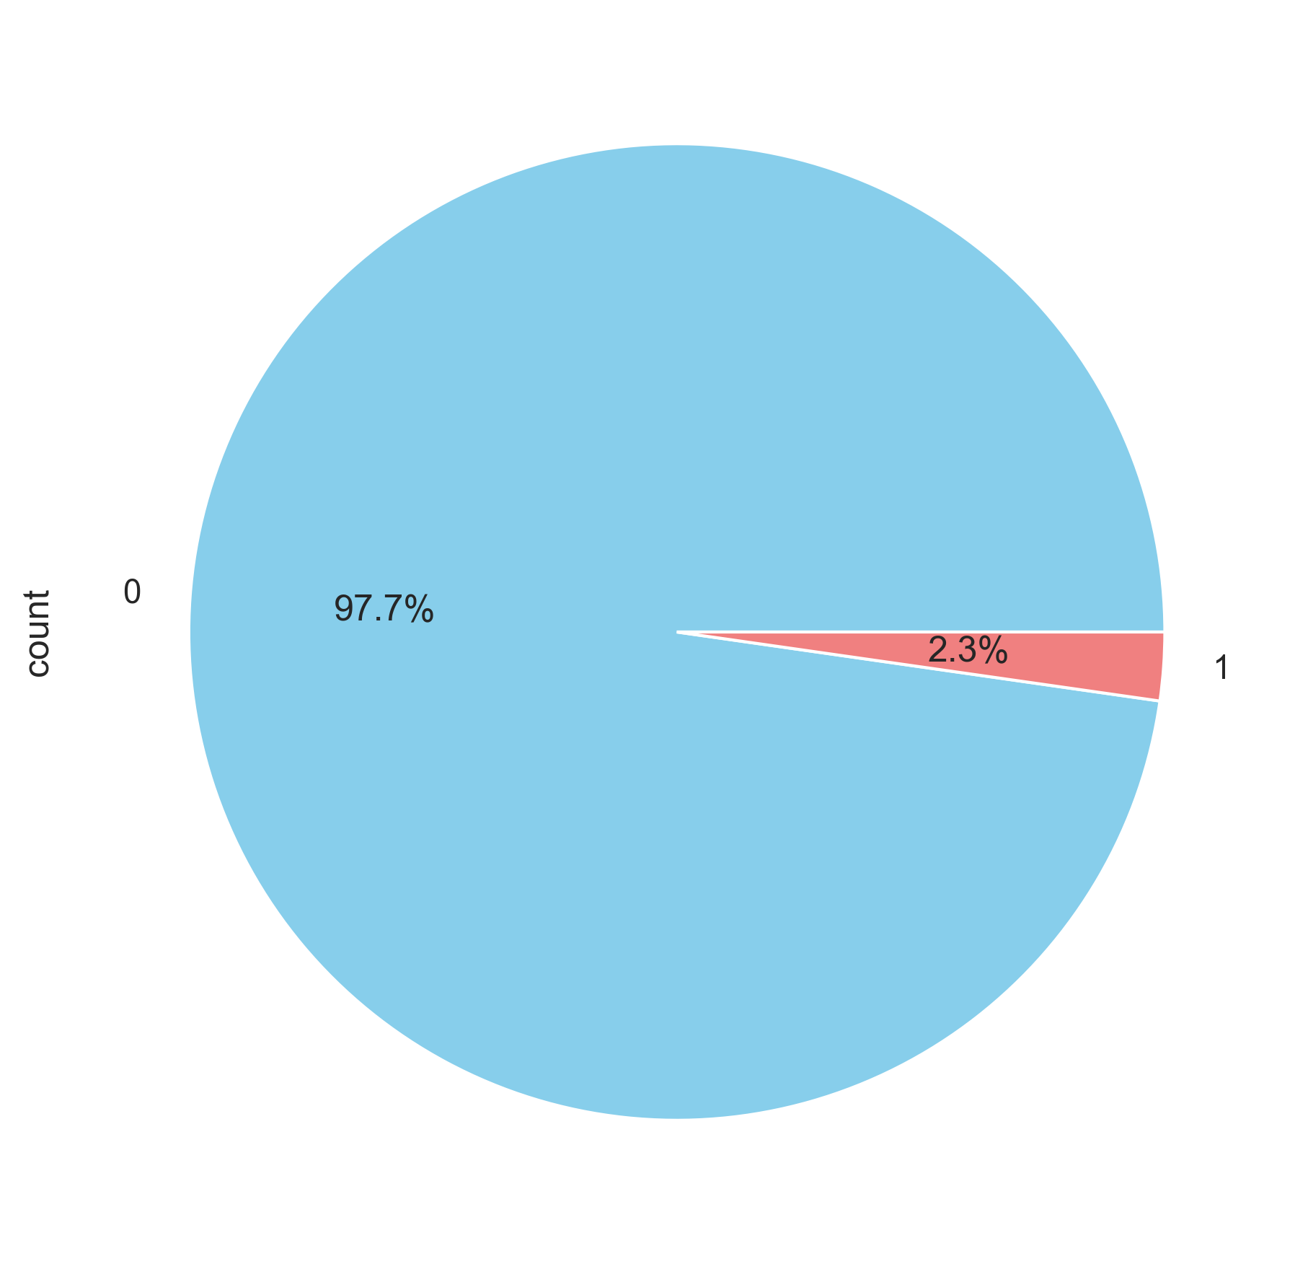
Customer Loyalty Overview
Pie chart demonstrates the split between repeat and new bookings.
Indicates potential for loyalty programs.

Slide 12
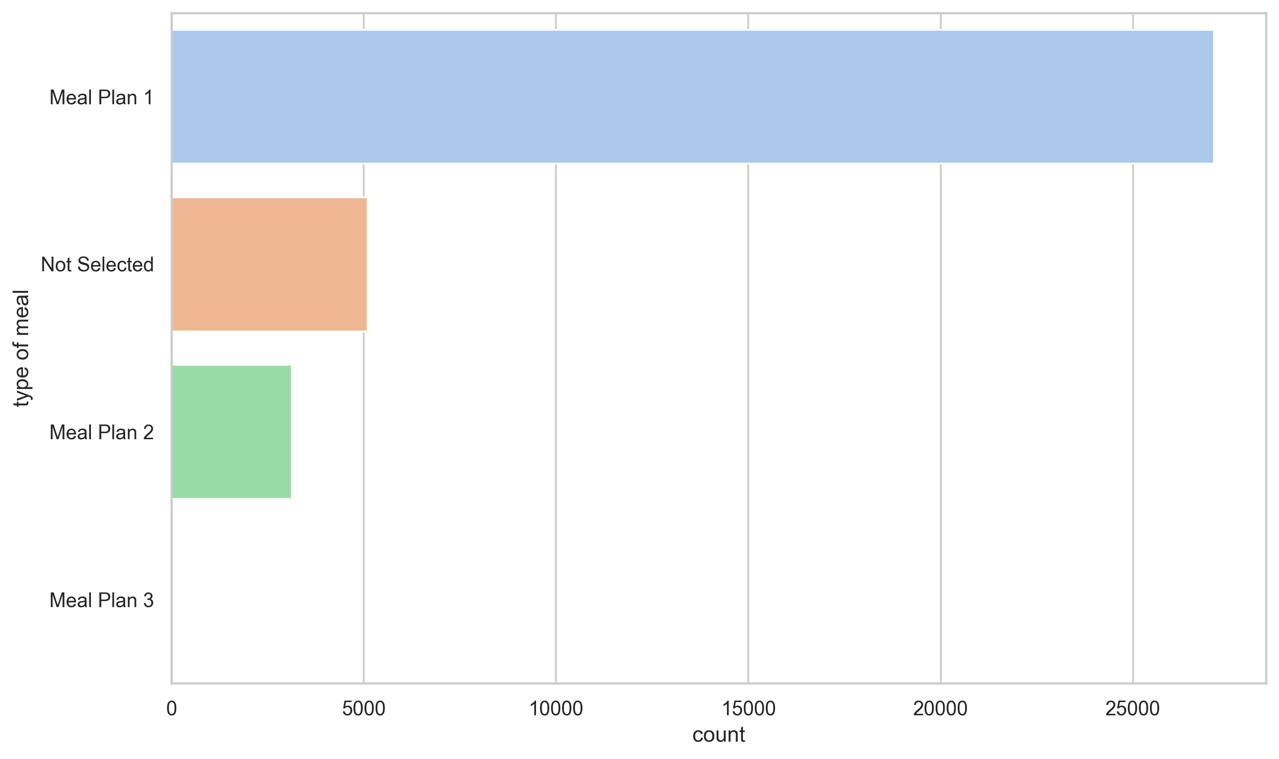
Meal Type Preferences
Meal preferences reveal additional dimensions of customer behavior.
Useful for cross-selling opportunities.

Slide 13
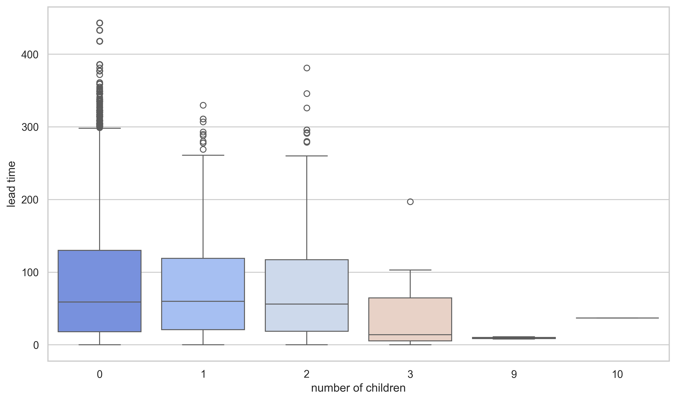
Children and Lead Time Dynamics
Family bookings exhibit distinct lead time patterns.
Important for understanding group behavior.

Slide 14
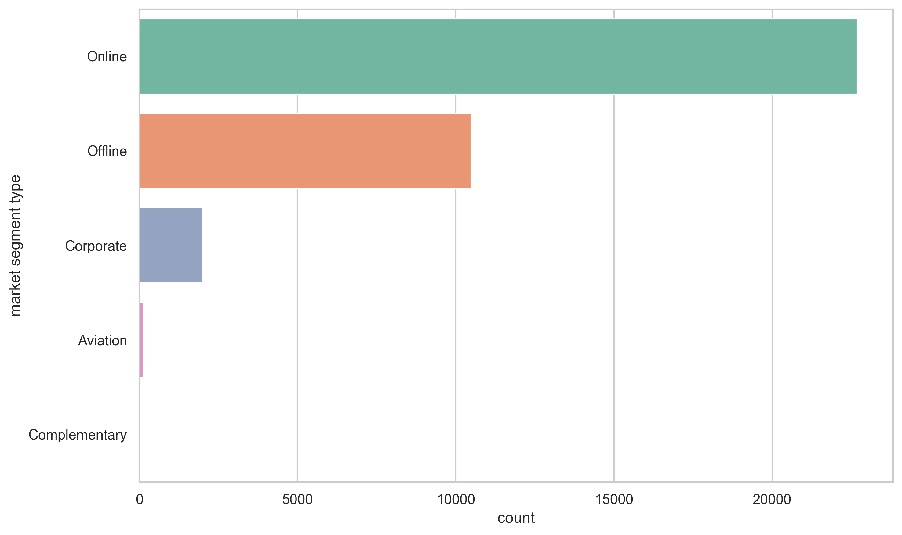
Market Segment Contributions
Certain market segments contribute disproportionately to bookings.
Targets for focused marketing efforts.

Slide 15
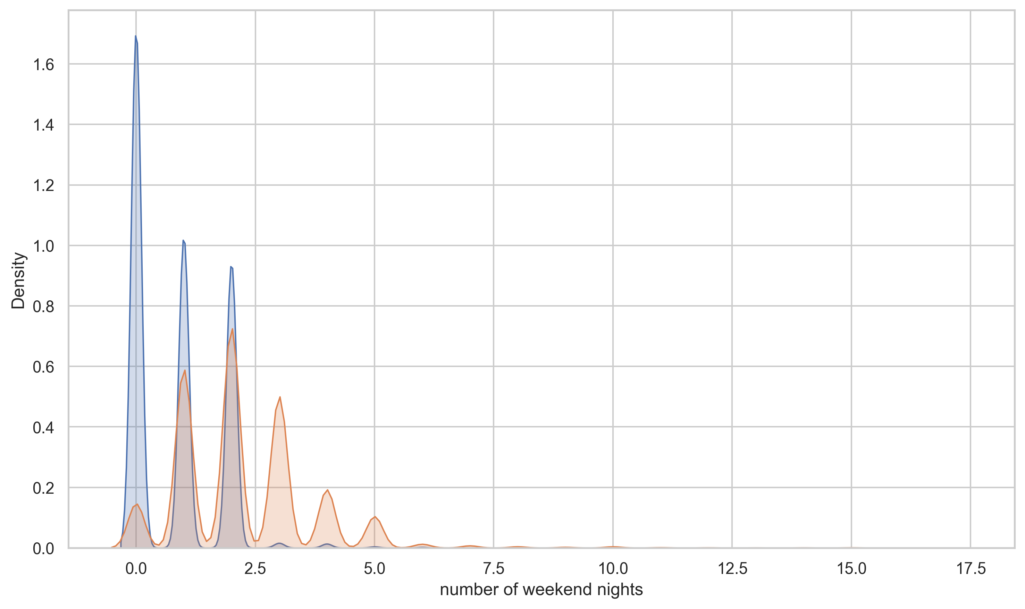
Weekend vs. Week Night Stays
Different patterns in weekend and weekday bookings.
Helps in resource planning and staffing.

Slide 16
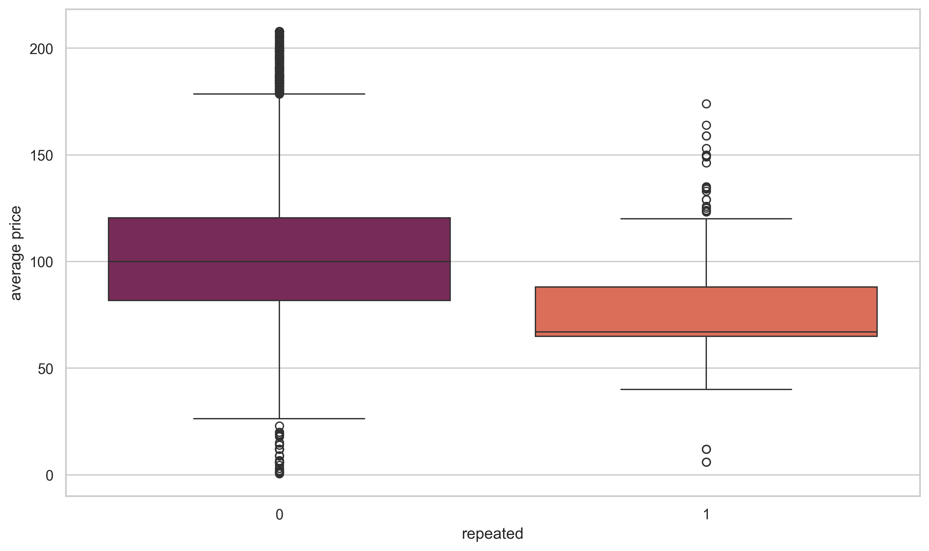
Repeat vs. New Guest Pricing
Pricing differences between repeat and new guests are significant.
Potential for loyalty rewards and incentives.

Slide 17
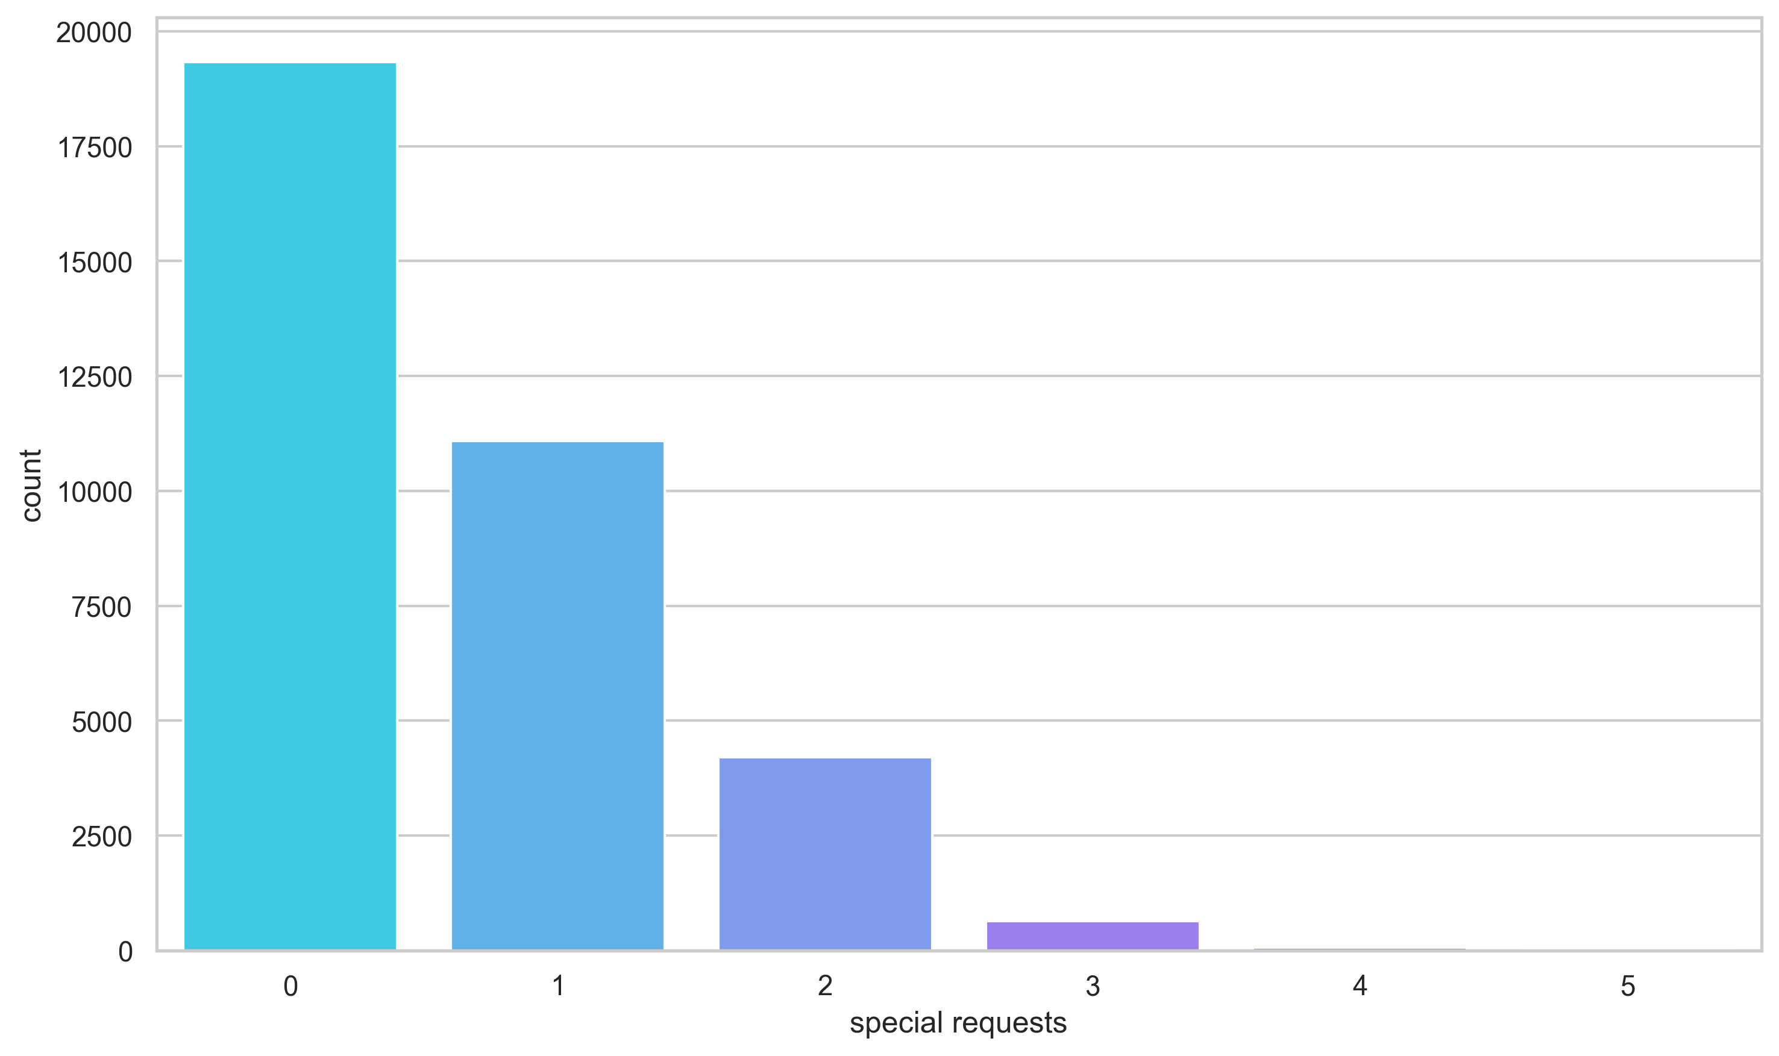
Special Request Frequencies
Most bookings have minimal special requests
Baseline service expectations are clear.

Slide 18
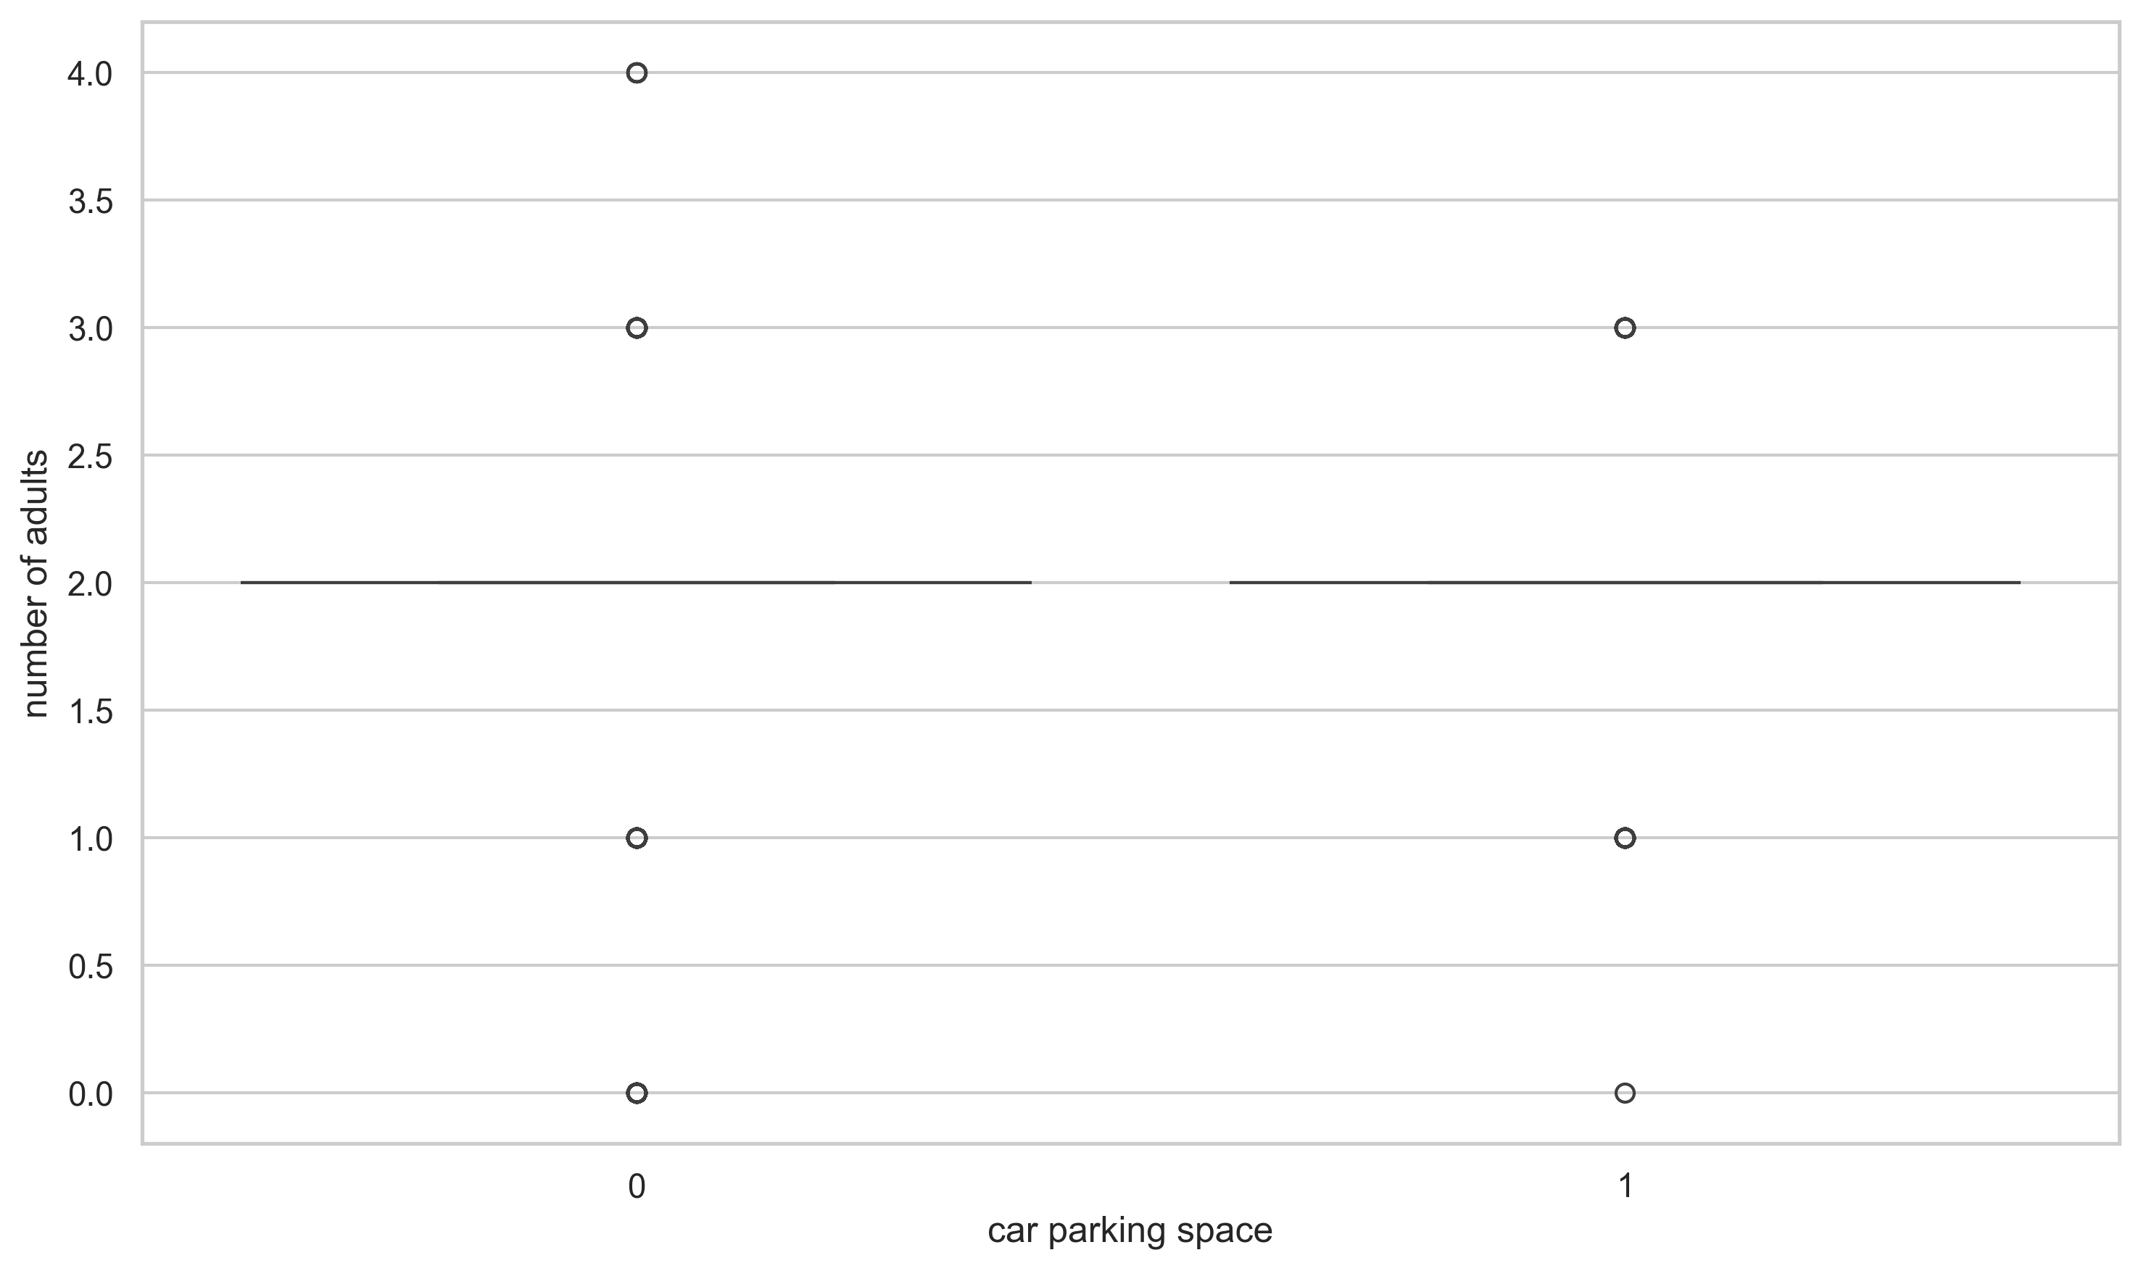
Parking Requirements vs. Group Size
Larger groups often require additional parking.
Insights for facility planning.

Slide 19
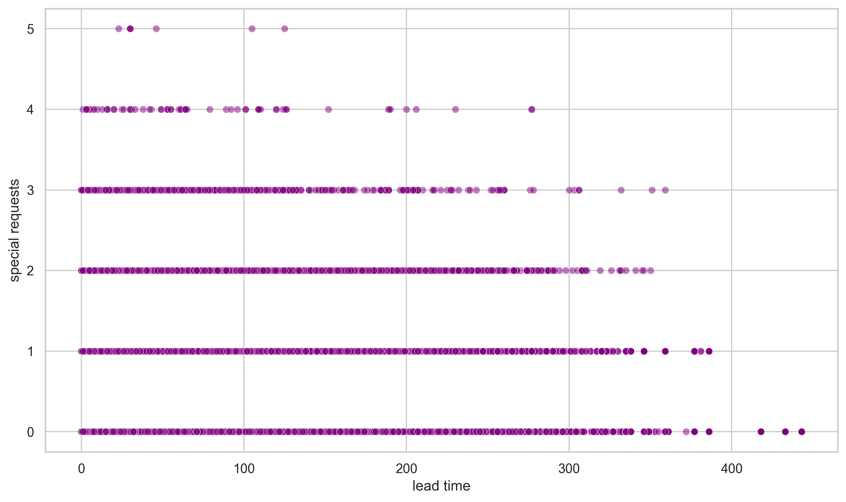
Lead Time & Special Requests Relationship
Longer lead times are linked with more special requests.
Impacts service planning and resource allocation.

Slide 20
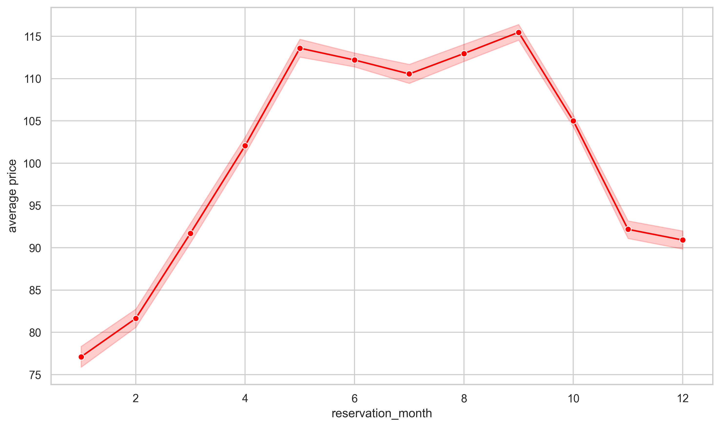
Price Trends Across Months
Seasonal fluctuations in pricing are evident.
Crucial for adjusting pricing strategies.

Slide 21
Additional Insights &Recommendations
Additional Insights:
• Online booking channels show emerging trends.
• Some customer segments are highly sensitive to lead times.
Strategic Recommendations:
• Implement dynamic pricing models during peak seasons.
• Develop targeted loyalty programs based on customer behavior.
• Optimize staffing and resource allocation based on booking trends.
• Enhance digital marketing to capture high-value segments.

Slide 22
Conclusion & Q&A
Key Takeaways:
• Strong seasonal and pricing trends were identified.
• Customer profiles and loyalty insights drive strategic opportunities.
Next Steps:
• Refine predictive models for cancellations.
• Implement targeted marketing and dynamic pricing strategies.
• Leverage insights for operational improvements.
Thank you for your attention!

